Slide 1
EXP Dining Philosophers Problem

Slide 2
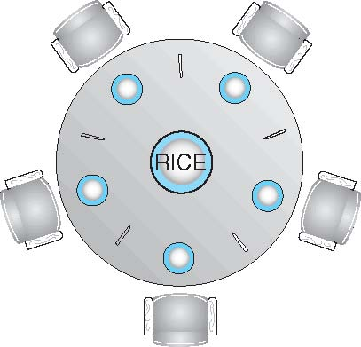



Dining-Philosophers Problem
Philosophers spend their lives alternating thinking and eating
When thinking
Don’t interact with their neighbors
When hungry-
A philosopher needs both their right and left chopstick to eat.
A hungry philosopher may only eat if there are both chopsticks available

Slide 3
Dining-Philosophers Problem
Occasionally try to pick up 2 chopsticks that are closest to her to eat from bowl
Chopsticks that are between her and her left and right neighbor
Pick up only one at a time
Need both to eat, then release both when done

Slide 4
Dining-Philosophers Problem
Classic Synchronization problem
Example of large class of concurrency control problems
Represents the need to allocate several resources among several processes
in a deadlock free and starvation free manner

Slide 5
Dining-Philosophers Problem
5 Philosophers share a common circular table
Surrounded by 5 chairs=each belonging to one philosopher
Center of table ->Bowl of rice
Five single chopsticks
Shared data
Bowl of rice (data set)
Semaphore chopstick [5] initialized to 1

Slide 6
Semaphore Solution for Dining-Philosophers Problem
Grab the chopstick –By Executing wait operation on the semaphore
Release the chopstick-By executing the signal operation on the appropriate semaphore
Semaphore chopstick [5] initialized to 1

Slide 7
Semaphore Solution for Dining-Philosophers Problem Algorithm
The structure of Philosopher i:
do {
wait (chopstick[i] );
wait (chopStick[ (i + 1) % 5] );
// eat
signal (chopstick[i] );
signal (chopstick[ (i + 1) % 5] );
// think
} while (TRUE);

Slide 8
Semaphore Solution for Dining-Philosophers Problem Algorithm
The structure of Philosopher i:
do {
wait (chopstick[i] );
wait (chopStick[ (i + 1) % 5] );
// eat
signal (chopstick[i] );
signal (chopstick[ (i + 1) % 5] );
// think
} while (TRUE);
Philosopher i has picked up the chopsticks on his sides. Then the eating function is performed.
Philosopher i has eaten and put down the chopsticks on his sides. Then the philosopher goes back to thinking.

Slide 9
Semaphore Solution for Dining-Philosophers Problem Algorithm
What is the problem with this algorithm?

Slide 10
Semaphore Solution for Dining-Philosophers Problem Algorithm
What is the problem with this algorithm?
Algorithm Guarantees that No two neighbors are eating simultaneously
Still Must be rejected
Why?

Slide 11
Semaphore Solution for Dining-Philosophers Problem Algorithm
Why?
Possibility of deadlock
If all 5 philosophers are hungry simultaneously and each grabs left chopstick
All elements of chopsticks will be =0
When each philosopher tries to grab her right chopstick, delayed forever

Slide 12
Semaphore Solution for Dining-Philosophers Problem Algorithm
Deadlock handling
Allow at most 4 philosophers to be sitting simultaneously at the table.
Allow a philosopher to pick up the forks only if both are available (picking must be done in a critical section)
Use an asymmetric solution --
Odd-numbered philosopher picks up first the left chopstick and then the right chopstick.
Even-numbered philosopher picks up first the right chopstick and then the left chopstick

Slide 13
Problems with Semaphores
Incorrect use of semaphore operations:
signal (mutex) …. wait (mutex)
wait (mutex) … wait (mutex)
Omitting of wait (mutex) or signal (mutex) (or both)
Deadlock free solution does not necessarily eliminate the possibility of starvation
Deadlock and starvation are possible.

Slide 14
Monitors

Slide 15
Monitors
A high-level synchronization construct
Set of programmer defined operators
Declaration of variables
whose value define the state of an instance of the type
Bodies of procedures
that implement operations on the type

Slide 16
Syntax of Monitors
monitor monitor-name
{
// shared variable declarations
procedure P1 (…) { …. }
procedure Pn (…) {……}
Initialization code (…) { … }
}
}

Slide 17
Monitors
Abstract data type, internal variables only accessible by code within the procedure
Procedure defined within the monitor can access only those variables
declared locally within the monitor and
its formal parameters.
monitor monitor-name
{
// shared variable declarations
procedure P1 (…) { …. }
procedure Pn (…) {……}
Initialization code (…) { … }
}
}

Slide 18
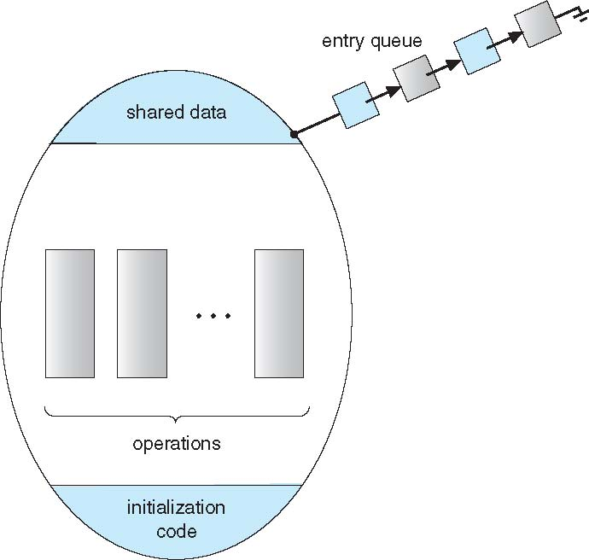
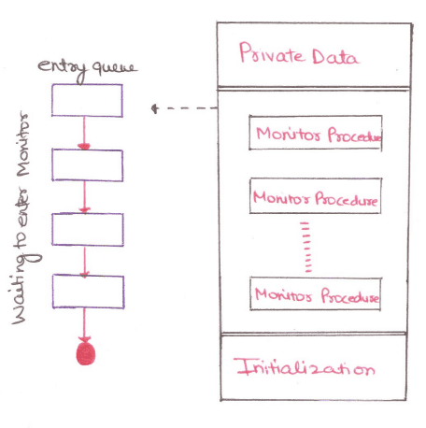
Schematic view of a Monitor

Slide 19
Monitors
It is the collection of condition variables and procedures combined together in a special kind of module or a package.
The processes running outside the monitor can’t access the internal variable of the monitor but can call procedures of the monitor.
Only one process at a time can execute code inside monitors.

Slide 20
Monitors
Monitor ensures that
Only one process may be active within the monitor at a time
Prgmr does not need to
code the synchronization constraint explicitly
But not powerful enough to model some synchronization schemes
Need to define additional condition construct

Slide 21
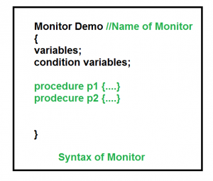
Condition Variables
Prgmr can define one or more condition variables
condition x, y;
Only Two operations are allowed on a condition variable:
x.wait()
x.signal()

Slide 22
Condition Variables
x.wait() –
Process performing wait operation on any condition variable are suspended.
suspended until x.signal()
The suspended processes are placed in block queue of that condition variable.
x.signal() –
When a process performs signal operation on condition variable, one of the blocked processes is given chance.
resumes one of processes (if any) that invoked x.wait()
If no process is suspended, then it has no effect on the variable
State of x, As if the operation was never executed
In contrast to semaphore, state of semaphore always gets affected

Slide 23
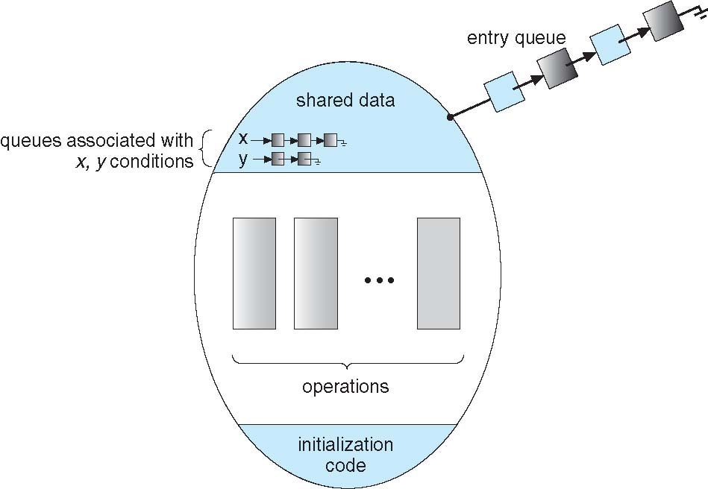
Monitor with Condition Variables

Slide 24
Condition Variables Choices
If process P invokes x.signal(), and
process Q is suspended in x.wait(),
Suspended process Q associated with condition x is invoked
what should happen next?
Both Q and P cannot execute in parallel.
If Q is resumed, then P must wait
Otherwise both P and Q will be active simultaneously within the monitor

Slide 25
Condition Variables Choices
Options include
Signal and wait – P waits until Q either leaves the monitor or it waits for another condition
Signal and continue – Q waits until P either leaves the monitor or it waits for another condition

Slide 26
Condition Variables Choices
Since P was already executing in the monitor,
Option 2 seems more reasonable
However, If P continues, the logical condition for which Q was waiting may no longer hold by the time Q is resumed
Both have pros and cons – language implementer can decide
Monitors implemented in Concurrent Pascal compromise
P executing signal immediately leaves the monitor, Q is resumed
Implemented in other languages including Mesa, C#, Java

Slide 27
Monitor Solution to Dining Philosophers
Deadlock free solution to Dining Philosophers Problem
To distinguish amongst the 3states in which the philosopher may be-
enum { THINKING; HUNGRY, EATING) state [5] ;
Philosopher i can set the variable state [i] = EATING only
if her two neighbors are not eating
(state [ (i +4) % 5] ! = EATING) and (state [ (i +1) % 5] '= EATING)

Slide 28
Monitor Solution to Dining Philosophers
Also need to declare
condition self[5];
in which i^{th} philosopher can delay herself when she is hungry but is unable to obtain the chopsticks she needs.
Distribution of chopsticks is controlled by the monitor DiningPhilosophers

Slide 29
Monitor Solution to Dining Philosophers
monitor DiningPhilosophers
{
enum { THINKING; HUNGRY, EATING) state [5] ;
condition self [5];
void pickup (int i) {
state[i] = HUNGRY;
test(i);
if (state[i] != EATING)
self[i].wait;
}
Pickup chopsticks
If unable to eat, wait to be signaled
Philosopher can delay herself when she is hungry but is unable to obtain the chopsticks she needs.

Slide 30
Monitor Solution to Dining Philosophers
monitor DiningPhilosophers
{
void putdown (int i) {
state[i] = THINKING;
// test left and right neighbors
test((i + 4) % 5);
test((i + 1) % 5);
}
Put down chopsticks
if right neighbor R=(i+1)%5 is hungry and
both of R’s neighbors are not eating,
set R’s state to eating and wake it up by signaling

Slide 31
Monitor Solution to Dining Philosophers
void test (int i) {
if ((state[(i + 4) % 5] != EATING) &&
(state[i] == HUNGRY) &&
(state[(i + 1) % 5] != EATING) ) {
state[i] = EATING ;
self[i].signal () ;
}
}
initialization_code() {
for (int i = 0; i < 5; i++)
state[i] = THINKING;
}
}
If her two neighbors are not eating and she is hungry
I.E. if my left and right neighbors are not eating
Set her state as eating
signal() has no effect during Pickup(),
but is important to wake up waiting hungry philosophers during Putdown()

Slide 32
Solution to Dining Philosophers
Each philosopher i invokes the operations pickup() and putdown() in the following sequence:
DiningPhilosophers.pickup(i);
EAT
DiningPhilosophers.putdown(i);
No deadlock, but starvation is possible

Slide 33
Solution to Dining Philosophers
Each philosopher, before starting to eat, must invoke the operation pickup().
This act may result in the suspension of the philosopher process.
After the successful completion of the operation, the philosopher may eat.
After eating, philosopher invokes putdown() and start to think

Slide 34
Solution to Dining Philosophers
Execution of Pickup(), Putdown() and test() are all mutually exclusive, i.e. only one at a time can be executing
No 2 neighbors are eating simultaneously
So No deadlock, but starvation is possible

Slide 35
Monitors
Advantages of Monitor:
Make parallel programming easier and
less error prone than using techniques such as semaphore.
Disadvantages of Monitor:
Monitors have to be implemented as part of the programming language .
The compiler must generate code for them.
This gives the compiler the additional burden of having to know what operating system facilities are available to control access to critical sections in concurrent processes.
Some languages that do support monitors are Java,C#,Visual Basic,Ada and concurrent Euclid.

